Slide 1
Smart Digital Balance
By:
Omar Radwan - 900153452
Ahmed Ibrahim - 900160265
Mohamed Tarek - 900153178

Slide 2
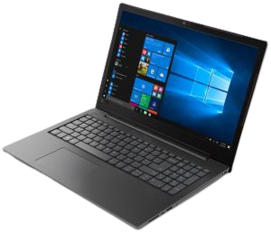
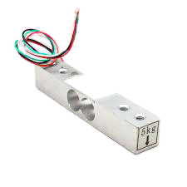
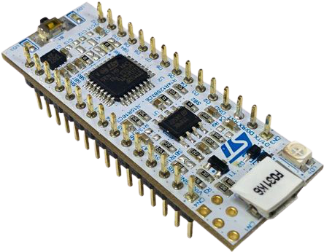
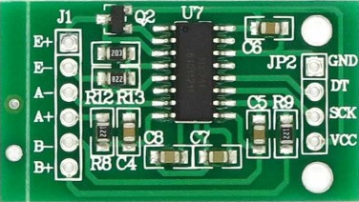
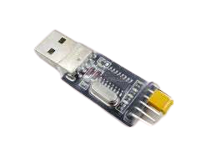
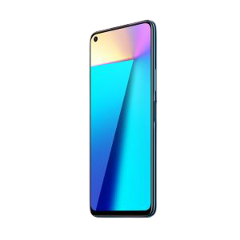
Our Components
Breadboard Components
STM32
HX711 Weight Sensor
Load Cell Sensor
Laptop
USB-to-TTL
Mobile Device with Serial Bluetooth Terminal

Slide 3
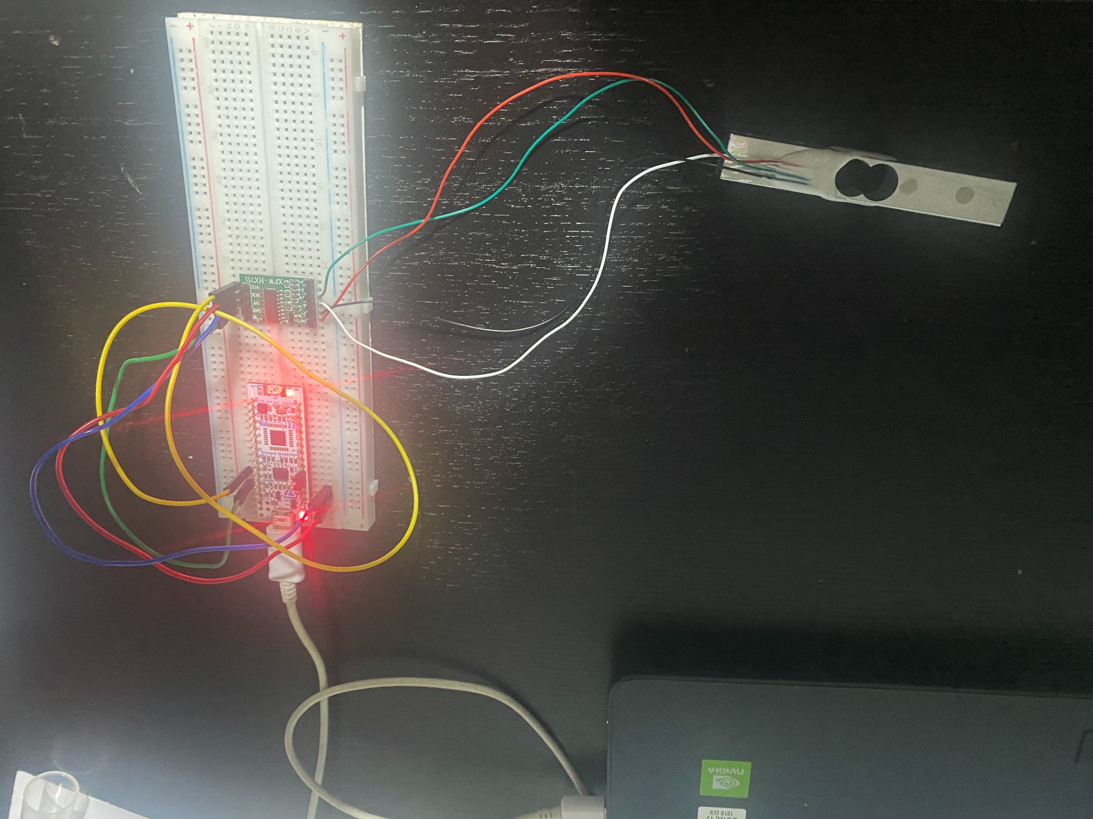

Slide 4
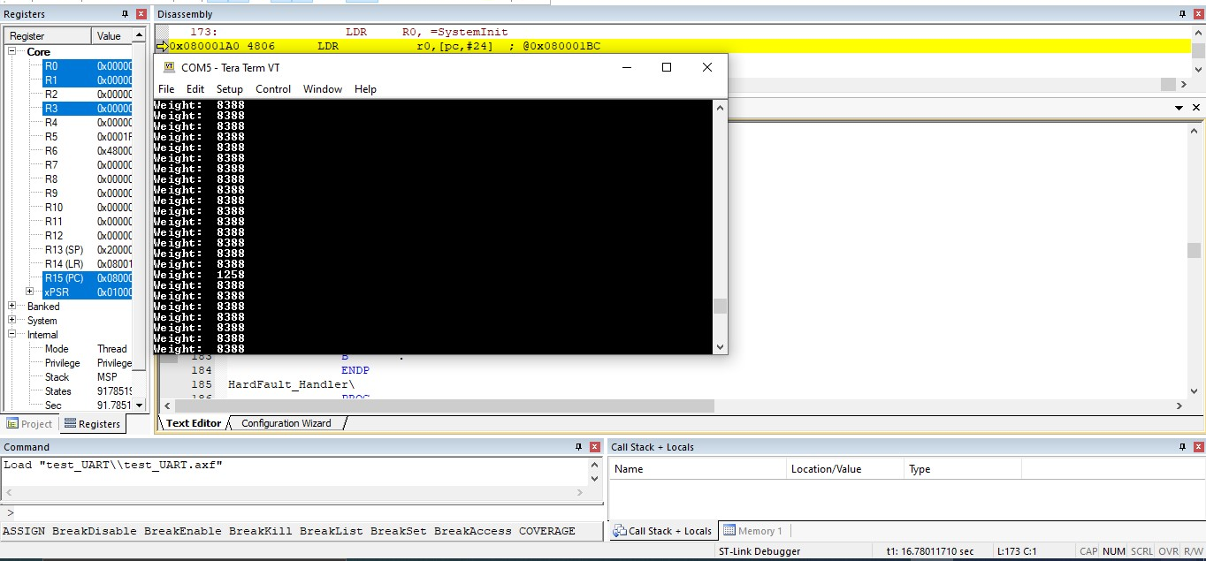
Our Progress till now

Slide 5
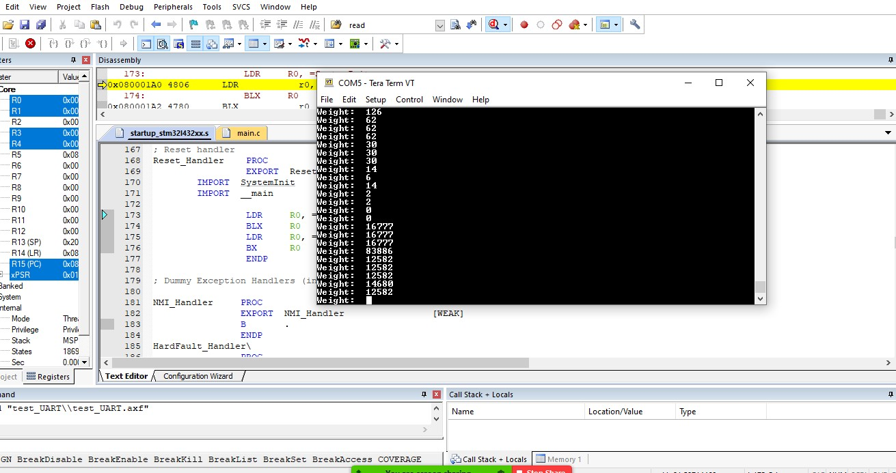

Slide 6
References
https://cdn.sparkfun.com/datasheets/Sensors/ForceFlex/hx711_english.pdf
https://www.robotshop.com/media/files/pdf/datasheet-3133.pdf
https://www.omega.com/en-us/resources/load-cells
https://www.ftdichip.com/Products/Cables/USBTTLSerial.htm
https://www.st.com/en/microcontrollers-microprocessors/stm32f303k8.html
https://www.keil.com/appnotes/docs/apnt_266.asp

